Slide 1

DEPARTMENT OF COMPUTER SCIENCE AND ENGINEERING NEXUS VIRTUAL ASSISTANT DOMAIN : ARTIFICIAL INTELLIGENCE
GUIDED BY ,
DR.R.PALSON KENNEDY,
B.E ,M.E ,PH.D
PRINCIPAL
SUBMITTED BY ,
ARCHANA B ( 411521104007 )
LAKSHMI PRIYA M ( 411521104059 )

Slide 2
ABSTRACT
Nexus is a desktop-based AI virtual assistant that enables users to perform tasks using natural language commands through voice or text.
Designed using Python, it integrates speech recognition, language understanding, and GUI components for seamless interaction.
Unlike traditional assistants, Nexus does not require internet for all functions or user accounts, promoting accessibility and privacy.
It improves productivity by automating routine desktop tasks and providing quick access to information.

Slide 3
INTRODUCTION
AI desktop assistants simulate human interaction using voice commands and natural language processing.
Nexus can perform tasks like sending emails, opening apps, providing weather updates, and more.
The assistant learns from user interactions, enhancing its responses over time for better accuracy.
Built in Python, it leverages libraries like SpeechRecognition and Pyttsx3 for core functionalities.

Slide 4
OBJECTIVE
To develop a virtual desktop assistant that understands and executes user commands using AI and NLP.
Aim is to simplify user interaction with computers by replacing manual operations with voice commands.
Ensure offline functionality for privacy and convenience without account login requirements.
Increase user productivity by integrating multitasking and real-time task execution features.

Slide 5
LITERATURE REVIEW
Year | Author | Title | Methodology | Disadvantage
2022 | Bermuth, D., Poeppel, A., Reif, W. | Jaco: An Offline Running Privacy-aware Voice Assistant | Developed an offline, privacy-focused assistant using a skill-based modular architecture. Runs on low-end devices like Raspberry Pi and supports multiple languages. | Limited conversational depth; lacks real-time web integration; not ideal for complex queries.
2023 | Thomas, R., Surya, V.S., Mathew, T.A., Thomas, T. | Voice Based Intelligent Virtual Assistant for Windows using Pythont | Used Python with speech recognition and BERT NLP for real-time task execution and summarization. GUI-based interface for accessibility. | Dependent on fixed command sets; lacks advanced error handling; limited generalizability.

Slide 6
LITERATURE REVIEW
Year | Author | Title | Methodology | Disadvantage
2023 | Pratap, A. | Virtual AI Assistant | Built a voice-enabled Python assistant with speech recognition, task automation (emails, searches), and personalized interactions using APIs. | Low adaptability to unseen queries; lacks offline capabilities; limited multi-turn conversation support.
2022 | Piya, K., Shrestha, S., Frank, C., Jebessa, E., Khan, T. | Addressing Selection Bias in Voice Assistance | Focused on inclusivity by training voice recognition models on diverse datasets using deep learning for accent/gender fairness. | Implementation challenges; high data requirements; bias mitigation not yet fully foolproof.

Slide 7
LITERATURE REVIEW
Year | Author | Title | Methodology | Disadvantage
2023 | Gupta, D. | Building a Voice-Controlled Virtual Assistant in Python | Created using PyWhatKit, Wikipedia, and OpenCV to perform system tasks, send messages, play media, and search online. | Relies heavily on third-party APIs; maintenance required to keep dependencies functional.
2022 | Neelkanth, R., Jaiswal, R., Jain, S. | Desktop Voice Assistant Using Python | Windows-based assistant using Python for automation, file handling, and app control through voice commands. | OS-specific (Windows); lacks modularity; limited natural conversation ability.

Slide 8
PROBLEM STATEMENT
Existing assistants (e.g., Siri, Alexa) depend heavily on internet and user account logins.
These systems often raise privacy concerns and lack offline support.
Users without consistent internet access or those who prioritize privacy are limited by current solutions.
There is a need for a system that operates offline, is platform-specific (desktop), and user-friendly.

Slide 9
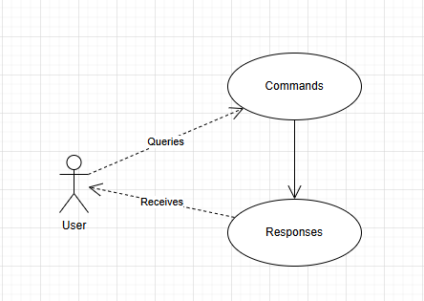
USECASE DIAGRAM

Slide 10
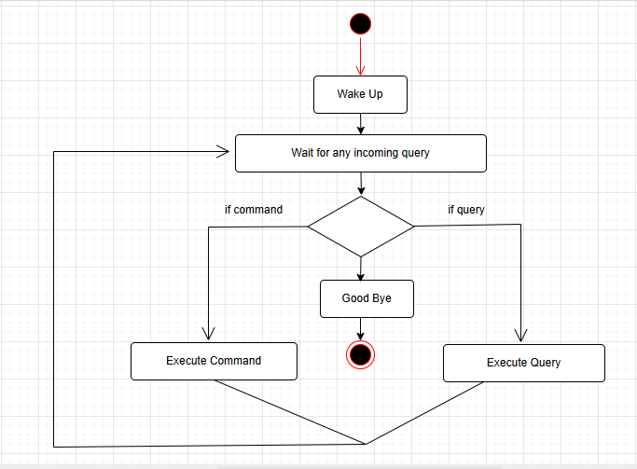
ACTIVITY DIAGRAM

Slide 11
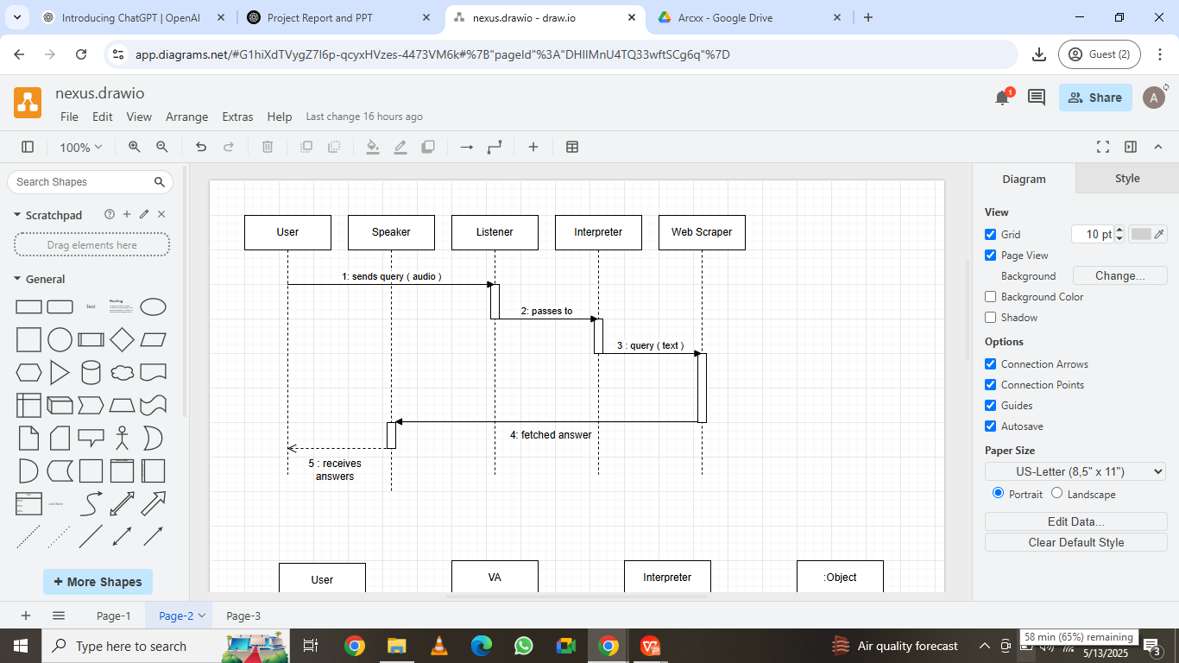
SEQUENCE DIAGRAM FOR QUERY RESPONSE

Slide 12
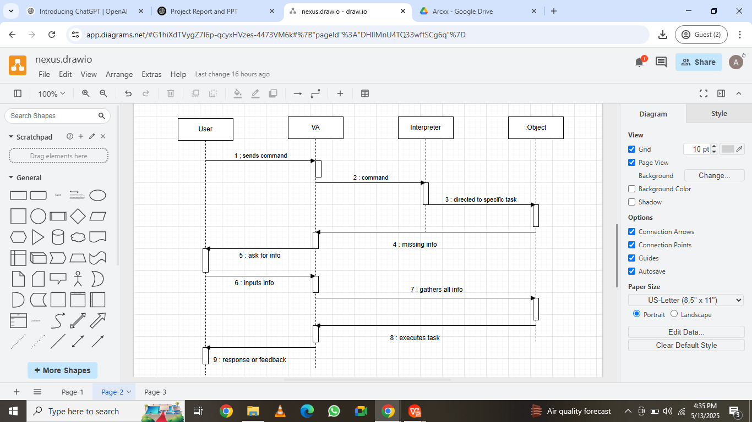
SEQUENCE DIAGRAM FOR TASK EXECUTION

Slide 13
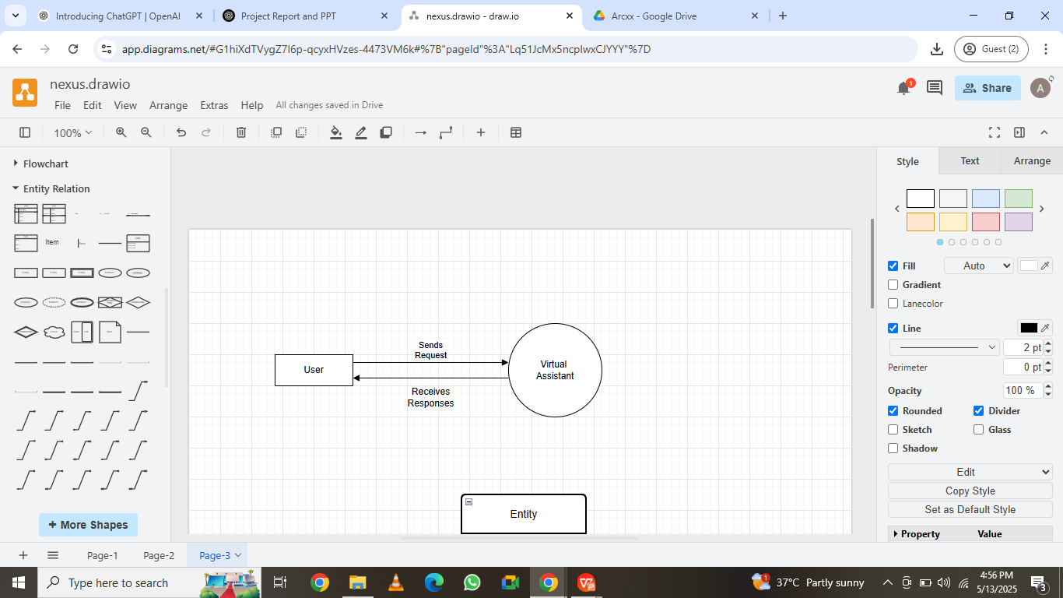
DATAFLOW DIAGRAM

Slide 14
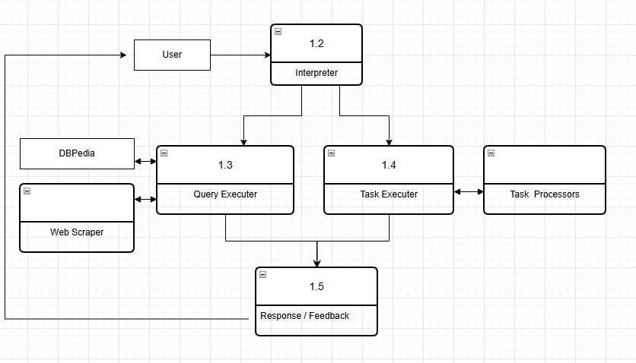
DFD LEVEL 1

Slide 15
METHODOLOGY
Step 1:
Start the Assistant
Launch Nexus through a simple desktop interface.
Accepts user commands through voice or text input.
Step 2:
Understand the Command
The assistant checks what the user said or typed.
Matches it with pre-defined commands stored in a file.

Slide 16
METHODOLOGY
Step 3:
Perform the Task
Opens apps like Chrome, Word, Notepad, etc.
Searches the internet, fetches weather or Wikipedia info.
Solves math problems or starts a timer as requested.
Step 4:
Give the Response
Speaks the result out loud using text-to-speech.
Also shows the response on the screen (GUI window).

Slide 17
METHODOLOGY
Step 5:
Keep Running Until Exit
Keeps listening and waiting for more commands.
Ends when the user says “stop” or closes the app.
Step 6:
Learn and Improve (Future Plan)
Can be upgraded to learn from user behavior.
Users can add their own custom commands later.

Slide 18
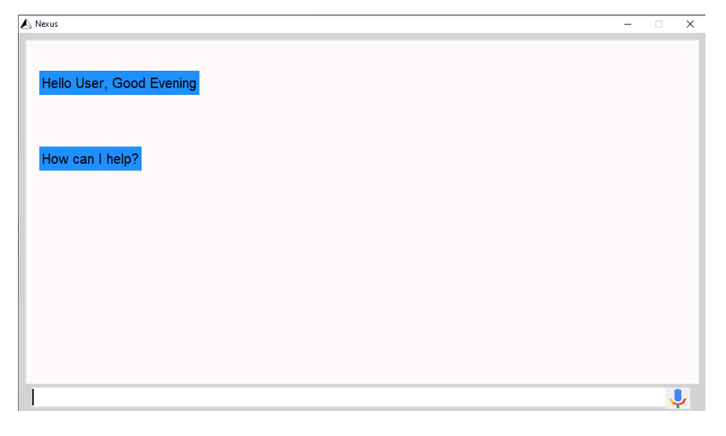
SNAPSHOTS
User Interface of Nexus Assistant

Slide 19
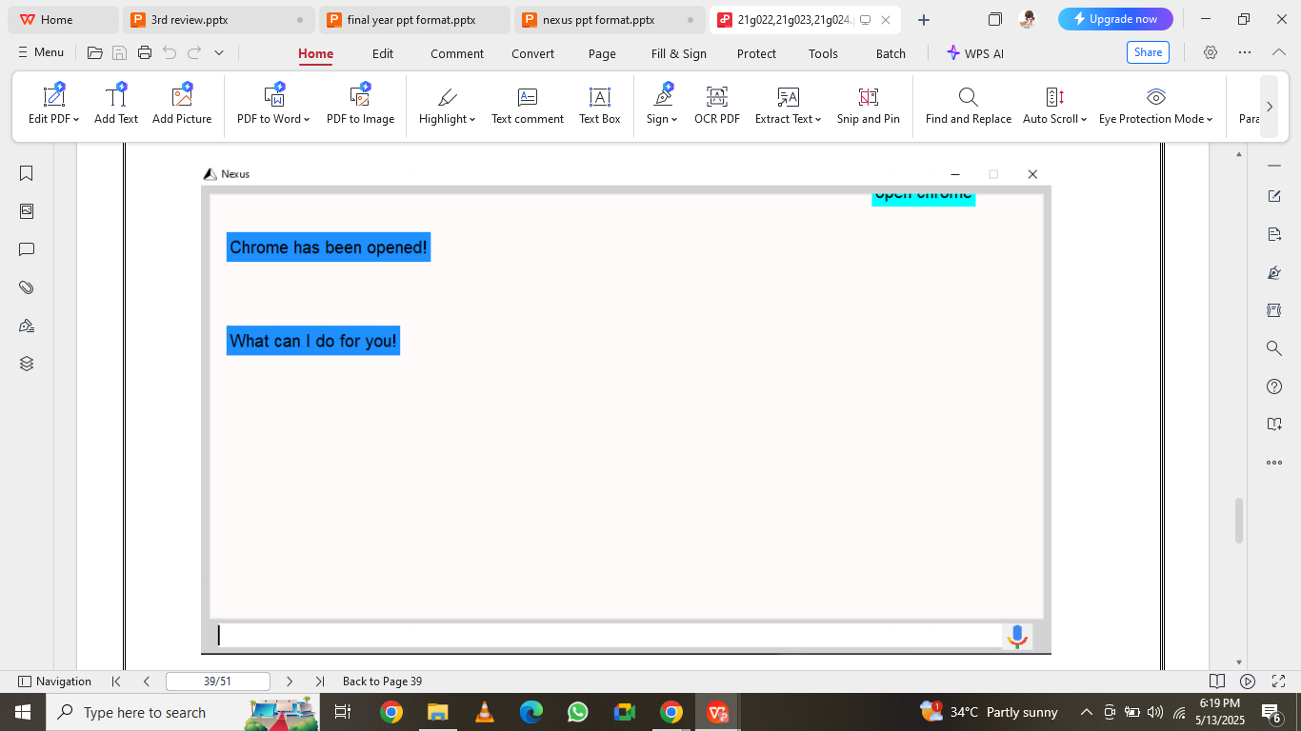
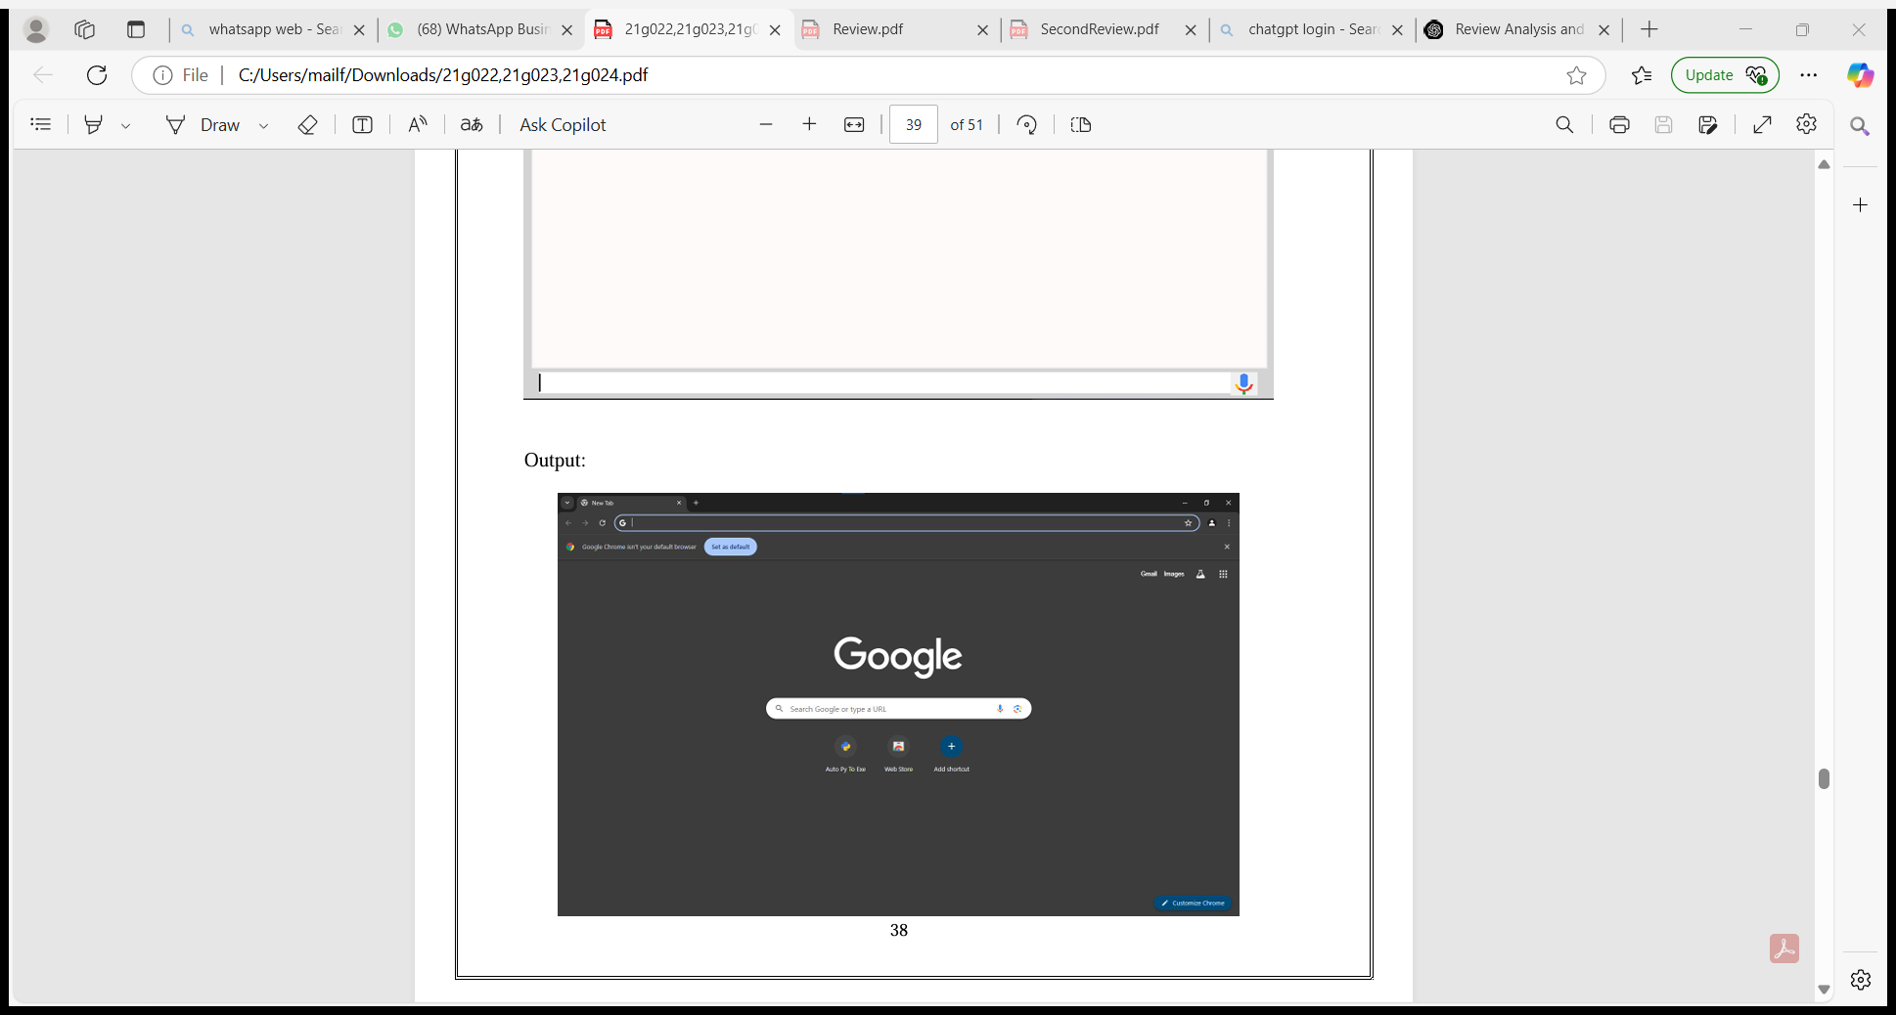
SNAPSHOTS
Command Execution
Command 1 : open chrome - It opens chrome browser
Output

Slide 20
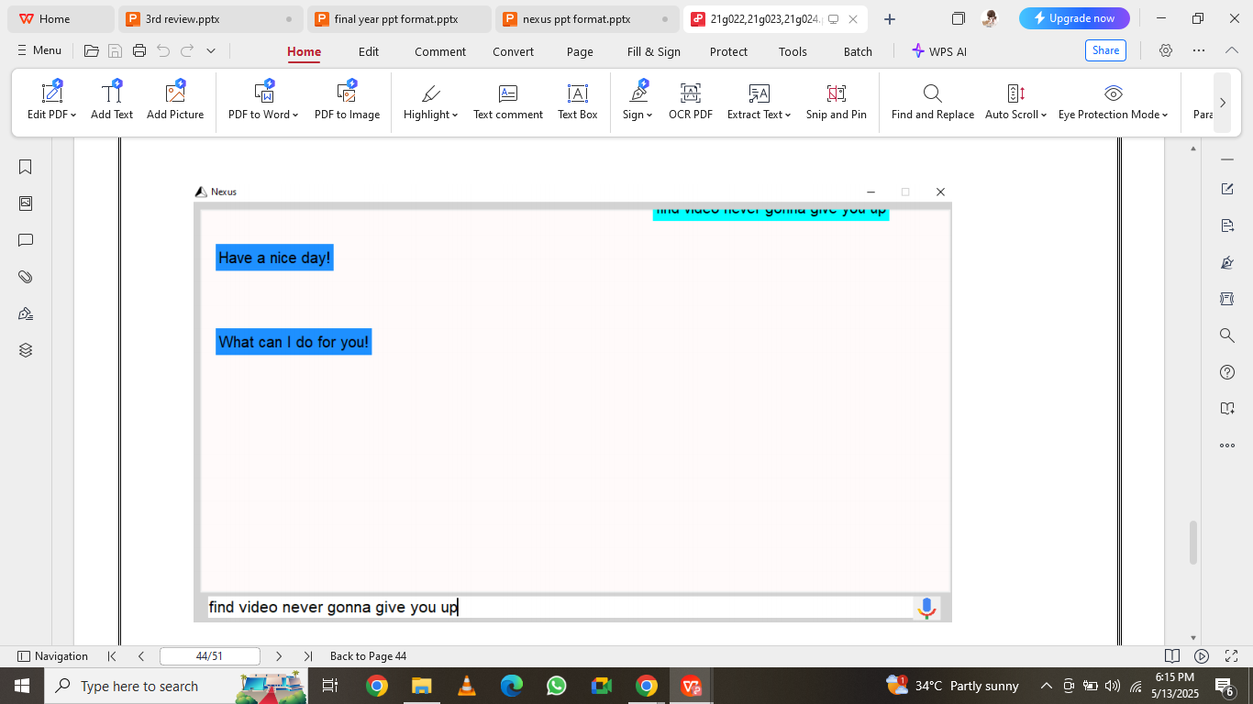
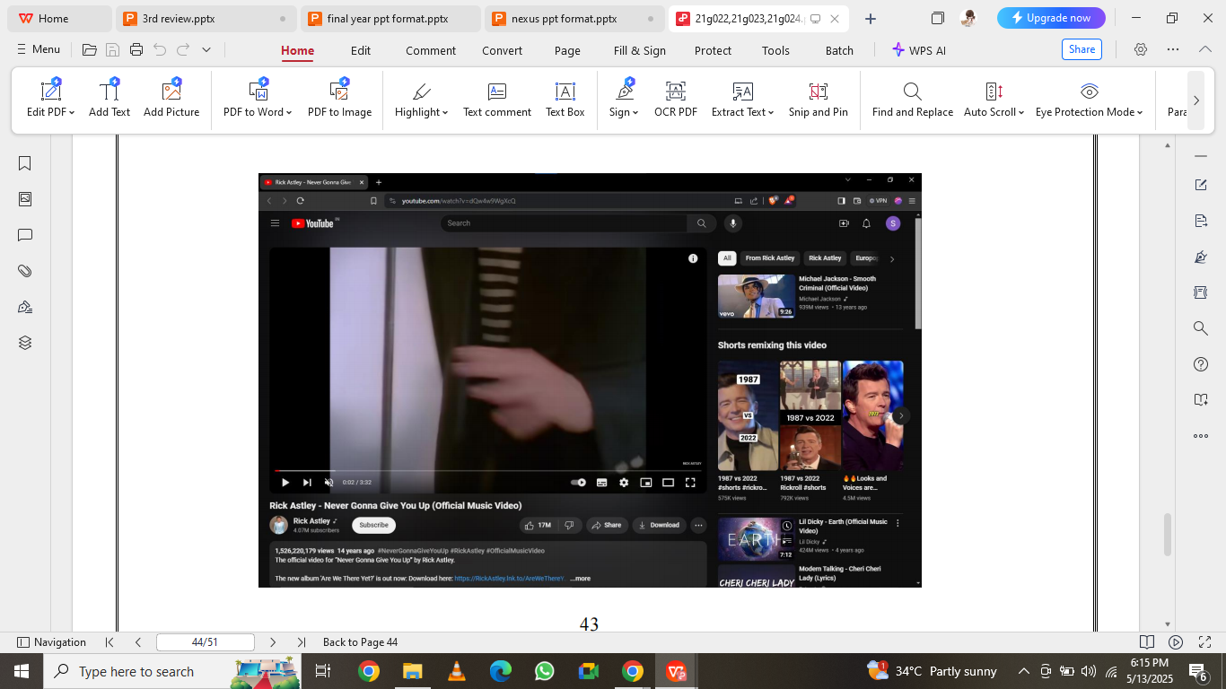
SNAPSHOTS
Command 2 :
Findvideo - It finds youtube video and open it in browser
Output

Slide 21
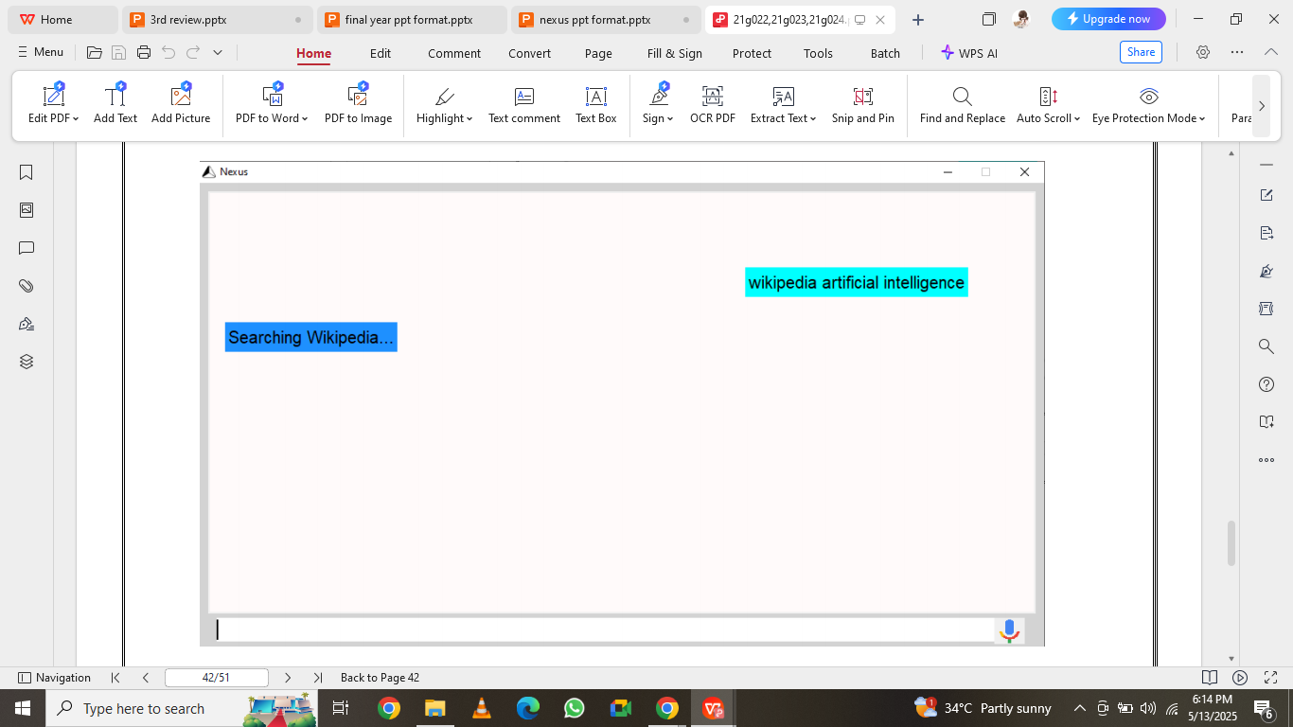
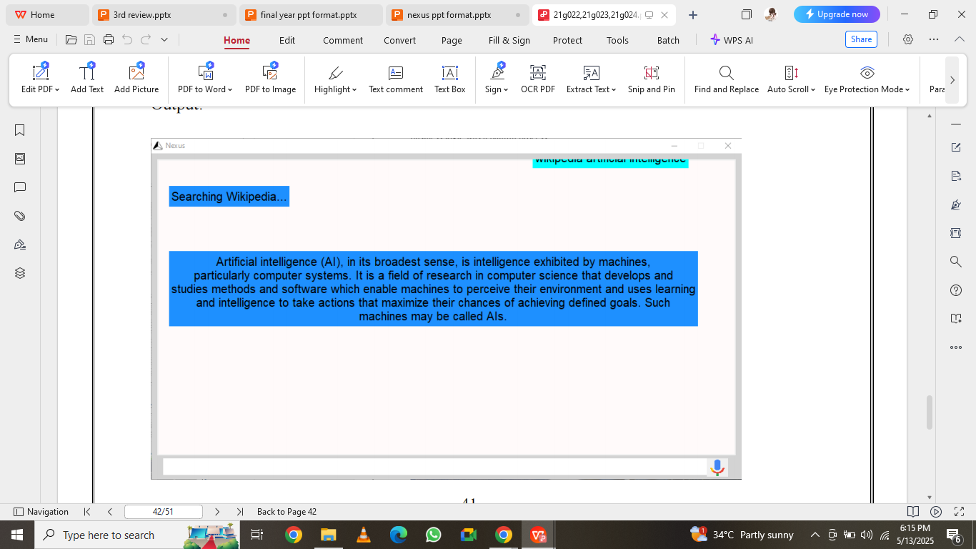
SNAPSHOTS
Command 3 :
Wikipedia - It summarizes information from the Wikipedia about a topic.
Output

Slide 22
COMPARISON
Feature | Existing Systems (Siri, Alexa, Google Assistant, etc.) | Nexus Virtual Assistant
Internet Dependency | Always requires an internet connection for most tasks | Works offline for most tasks; internet used only when required (e.g., web search, weather)
Account Requirement | Requires login (Google, Apple, Amazon accounts) | No account or login needed to use the assistant
Platform | Mobile devices, smart speakers, cloud-based platforms | Desktop-specific (Windows/Linux) application
Data Privacy | Sends user data to cloud; privacy concerns exist | Operates locally; no data sent to external servers

Slide 23
COMPARISON
Feature | Existing Systems (Siri, Alexa, Google Assistant, etc.) | Nexus Virtual Assistant
Customization & Open Source | Closed source; limited customization | Fully customizable (command file editable, open source)
Voice & Text Input Support | Primarily voice input | Supports both voice and text inputs
Task Scope | Broad, including smart home control, messaging, etc. | Focused on desktop utilities (opening apps, searching, weather, etc.)
Setup & Usage Complexity | Requires device sync, cloud setup, app installs | Easy setup; single executable or script-based use

Slide 24
CONCLUSION
Nexus bridges the gap in voice assistant technology by enabling offline, account-free desktop interaction.
With multitasking, personalization, and privacy as core features, it is suitable for daily use.
Its modular design allows scalability for future additions like translation or calendar syncing.
Overall, it enhances computing productivity and user convenience through intelligent automation.

Slide 25
REFERENCE
[1] Patel, Anisha, David Zhang. “Artificial Intelligence Technologies and Applications for Language Learning: Literature Review.” Journal of Computer-Assisted Language Learning, Vol. 36, No. 3, 2023.
[2] Lisa Brown, Mark Stevenson. “A Systematic Review of Current Trends in Artificial Intelligence in Language Education.” Smart Journal of Language Studies, Vol. 7, No. 2, 2024.
[3] Lee, Hyejin, Robert Chen. “Potential of ChatGPT as a Digital Language Learning Assistant.” Int. Journal of Educational Technology in Higher Education, Vol. 20, 2023.
[4] Zhao, Lijun, Emily Carter. “Designing Language Learning with AI Chatbots: A Systematic Review.” Int. Journal of E-Learning & Distance Education, Vol. 40, No. 1, 2025.
[5] Kashav Piya et al. “Addressing the Selection Bias in Voice Assistance.” IEEE Access, 2022.

